Slide 1

Submitted by Group 4
• Kimberly Wessler • Cris Pena • Jajuan Graham • Chris Dobbin • Christine Espiritu

Slide 2
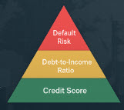
📊 Project Overview
This project investigates the effectiveness of machine learning algorithms in predicting credit risk using dataset from Kaggle. The goal is to build a model that improves predictive accuracy while maintaining transparency and fairness, thereby supporting responsible and inclusive lending decisions.

Slide 3
Workflow
📥 Data Ingestion
🧼 Data Preprocessing
📊 Data Analysis
🔀 Nueral Network Model
🌲 Random Forest Model Training
🧪 Model Evaluation

Slide 4
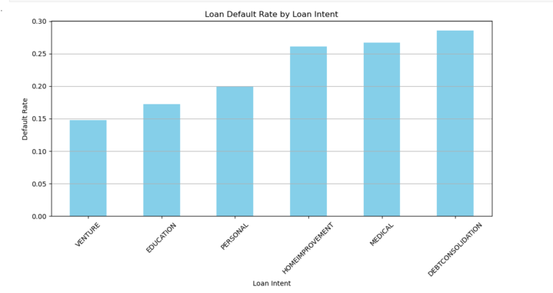
Key Factors
Age
Income
Home Ownership
Length of Employment
Loan Intent
Loan Grade
Loan Amount
Loan Interest Rate
Loan Status
Loan Percent Income
Default on file
Length of Credit History

Slide 5
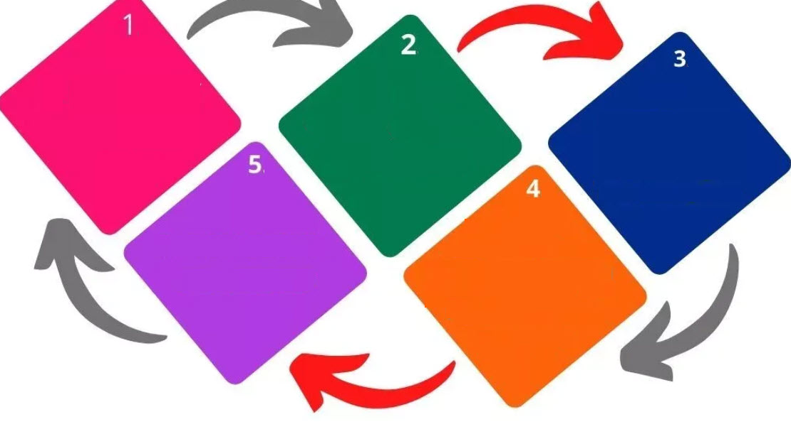
Data Preprocessing Pipeline
Dataset
Overview
Outlier Handling
Missing Value Treatment
Exploration and
Output
Applied one-hot encoding

Slide 6
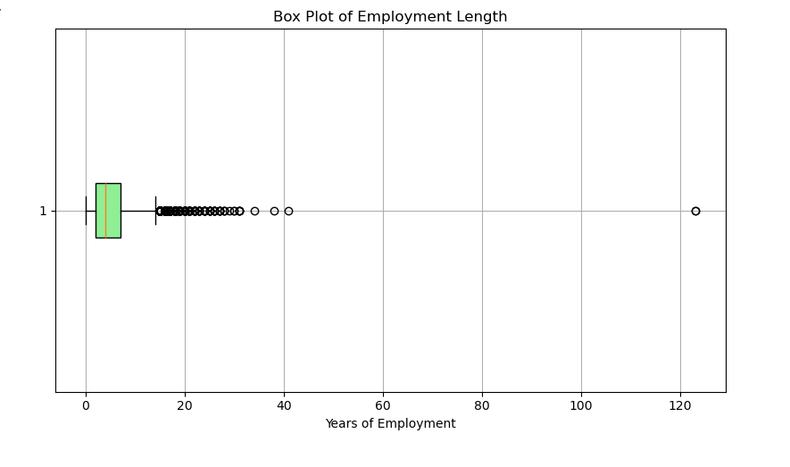
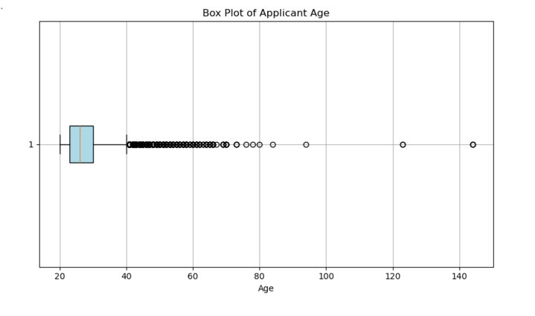
Outliers

Slide 7
Model Development
Model 1: Baseline Model
Used the Adam optimizer
Simple architecture with 1–2 dense layers
Each Layer had 16 –lowed for deeper networks with 2–4 layers and up to 256 units per layer. 128 units
Model 2: Enhanced Model
Introduced AUC as a secondary metric to better handle potential class imbalance.
Has deeper networks with 2–4 layers and up to 256 units per layer
Model Performance
Both models achieved 85% accuracy on test data.
Model 1 lacked overfitting protection and thus had lower generalizability.
Model 2 incorporated regularization and early stopping, making it more robust and production-ready.

Slide 8
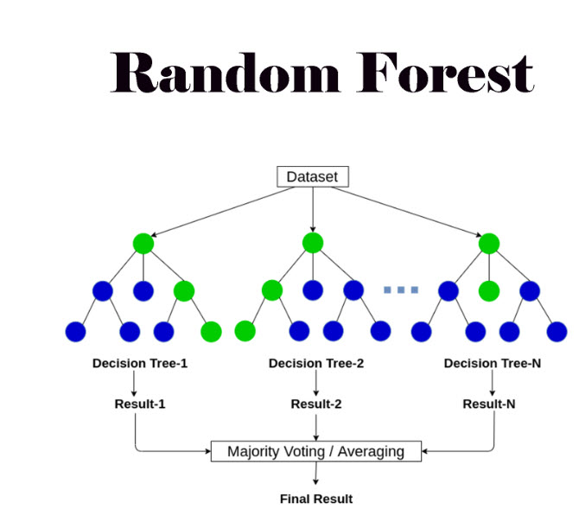
Random Forest Model Evaluation | Test 1 | Test 2 | Test 3
Accuracy | 92.01% | 92.32% | 92.62%
Precision | 91.89% | 94.07% | 98.59%
Recall | 62.50% | 65.46% | 66.67%
F1 Score | 74.40% | 77.20% | 79.55%

Slide 9
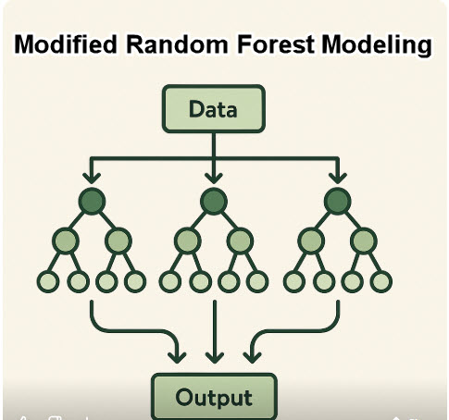
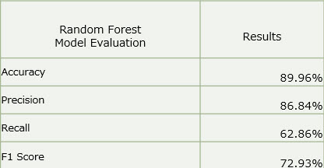

Slide 10
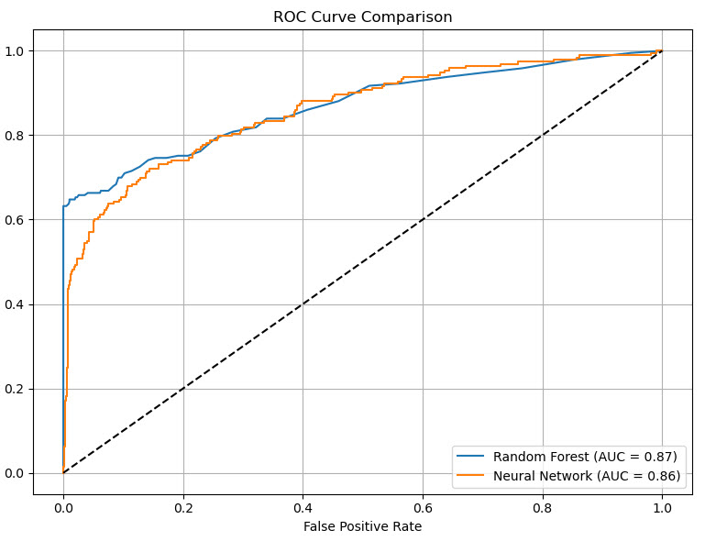
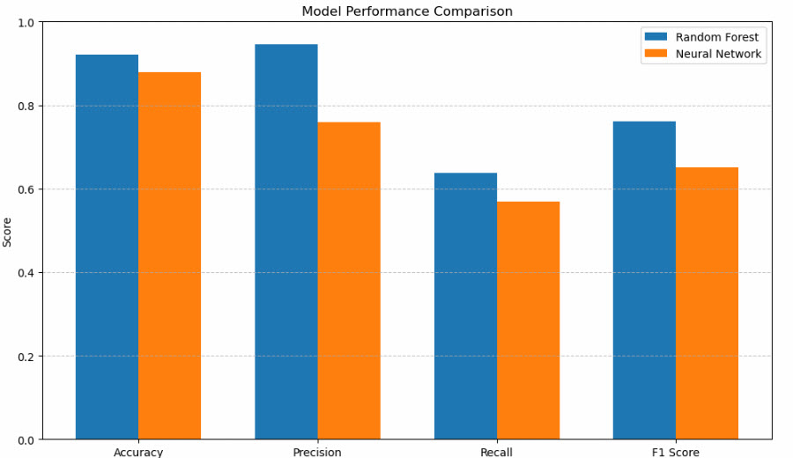
Model Comparison Graph

Slide 11
THANK YOU
• Kimberly Wessler • Cris Pena • Jajuan Graham • Chris Dobbin • Christine Espiritu

